Slide 1
ZeR0Con 2022 Old school New story
Escape From Hyper-V by Path Traversal
Notes:
Hello everyone, I’m glad to share my finding in Zer0con, My title is Old school, new story, escape from hyper-v by path traversal. Hope you can enjoy it, so let’s start now.

Slide 2

Who am I （VictorV）
Security Engineer at
Escape from VMware Workstation at TianfuCup 2018/2021.
Escape from ESXi by CVE-2018-6981 Privately
Escape from Hyper-V by Path Traversal
Found Bugs on Windows RDP Server, DNS, Hyper-V, VMware ESXi/Workstation, QEMU, KVM, Parallels Desktop
@vv474172261 vv.ttw@outlook.com
Notes:
First of all, let me introduce myself. My nickname is victorv, I worked at Cyber Kunlun as a security engineer, majoring in binary security research. I made two successful exploitation of VMware workstation at TianfuCup in 2018 and 2021, I also escaped from ESXi privately by cve-2018-6981 which is used in GeekPwn 2018 by another researcher. Last year, I found a path traversal on hyper-v, which could be used to escape from VirtualMachine. I also found some bugs on other products including RDP server side, DNS, hyper-v, qemu, kvm, parallels desktop. You can find me on twitter by this id, you can contact me by email, too.

Slide 3
Agenda
VM Types and Hyper-V Architecture
Attack Surfaces on Hyper-V
Enhanced Session Mode
RDP protocol
3 Cases of Escaping
Conclusion and Q&A
Notes:
Now, this is an outline, firstly, I will introduce virtual machine types and hyper-v architecture, then I will introduce potential attack surfaces, especially enhanced session mode. Next, Let's take a look at the RDP protocol, understand the place where you need to pay attention. After the paving is completed, we can start learning instances. They are all about path traversal, and they are very interesting. OK, let's begin.

Slide 4
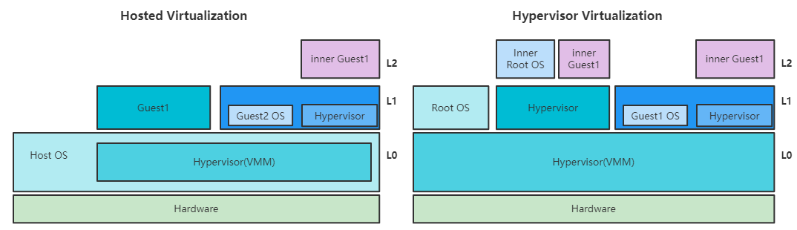
VM Types
Example:
VMware Workstation
QEMU/KVM
VirtualBox
Example:
ESXi(?)
Hyper-V
Xen
Notes:
For platform virtualization types, there are 2 types, on the left, virtual machine monitor( vmm for short) also called hypervisor, is running after the host OS has been booted. And guest operation system can run unmodified. We also call this type Full virtualization. For example, VMware workstation, qemu-kvm, VirtualBox belong to this type. On the right, the hypervisor is running upon hardware, host OS is running as a guest with privilege, it can manage hypervisor and guests by hypercall. Guests need to be specifically modified to run in this environment. We call this type Paravirtualization. Hyper-V is the typical example of this type. Though many people think ESXi belongs to this type, I think, ESXi's hypervisor is not running upon hardware, it has a host OS using vmkernel to manage hardware. And its guest doesn't need to be modified. To distinguish guest level, we call hypervisor L0, The first layer Guest is L1, the second layer Guest is L2. L2 Guest's types are similar to L1.

Slide 5
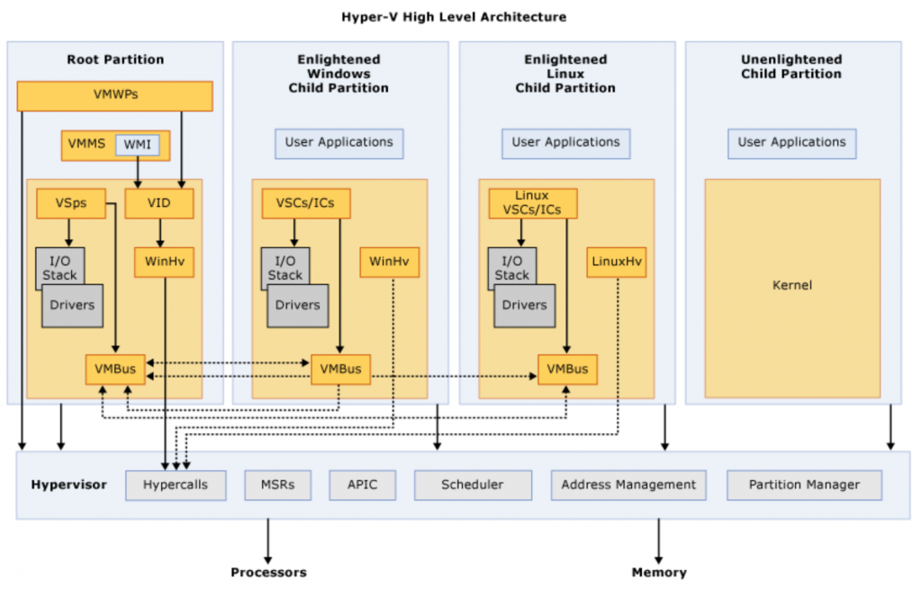
Hyper-V Architecture
https://docs.microsoft.com/en-us/virtualization/hyper-v-on-windows/reference/hyper-v-architecture
Notes:
Here is the architecture of hyper-v, HOST os is called root partition, the guest is called enlightened child partition. They communicate with each other by VMBus through hypercall instructions. Some virtual devices are emulated in the host kernel. some are emulated in user mode through IO. Special instructions are handled by the hypervisor, including hypercalls, MSR register operations, APIC related operations, scheduler, Address management and partition management. After a brief understanding, let's start watching its attack surfaces.

Slide 6
Hyper-V Attack Surfaces
Virtual Devices
Net, Storage, PCI, Display…
Hypervisor
Hypercall, APIC, MSR registers, Nested Virtualization, Other privileged instructions…
VMBus
Enhanced Session Mode
RDP protocol
Notes:
I classified Hyper-V's attack surface into the following four categories, including Virtual devices emulation, privilege instructions emulation, VMBus communication mechanism, enhanced session mode. Virtual Devices we are concerned mainly are network, storage, PCI and display. For Hypervisor, we mainly care about HyperCall, APIC, MSR register, nested virtualization, etc. vmbus, as hyper-v's specific communication mechanism, has many complex operations. We should pay more attention to it. The last one, enhanced session mode, it achieves very rich features through the RDP protocol, which will be the object we focus on discussing.

Slide 7
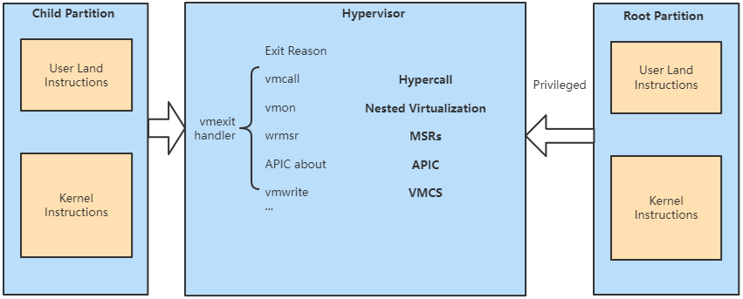
Hypervisor Attack Surfaces
Notes:
Let's take a closer look at each attack surface. When a special instruction is executed, a vmexit event will trigger to the hypervisor, some instructions can not be executed in the Guest userland, if the hypervisor doesn't check execution context well, it will cause a privilege problem which may allow guest user program gain privileged information. For guest kernel, it is allowed to execute many special instructions like vmcall, vmon, wrmsr, vmwrite and so on. Vmcall is used for hypercall. There are 245 hypercalls, but most of them are privileged which means only root partition is allowed to execute. Vmon is related to nested virtualization, if we run special instructions in L2, hypervisor mishandled, it may allow us to crash hypervisor or escape from L2 to L1 or from L2 to L0. vmwrite allows guest to configure VMCS, which is a major structure about how the hypervisor handles special instructions from L2. A typical example is talked in ¡°An EPYC escape: Case-study of a KVM breakout”.

Slide 8
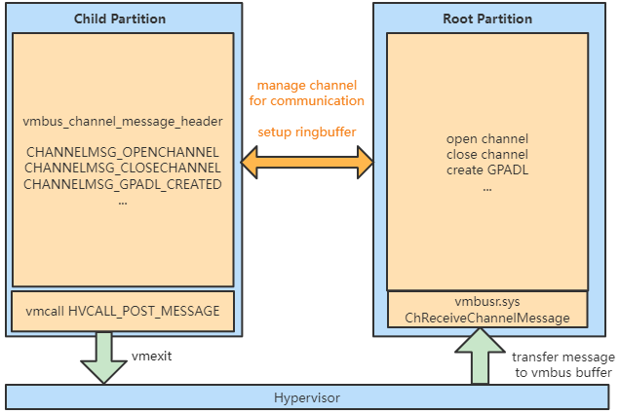
VMBus
Notes:
Guest can do a hypercall HVCALL_POST_MESSAGE to send vmbus command to host’s kernel. Vmbusr.sys will receive command message by the ChReceiveChannelMessage function. Thus, we can research its implementation without digging into the hypervisor. As you can see, guest can send openchannel, closechannel, create GPADL can other commands to the vmbus backend. After opening channels, virtual devices can communicate with the guest driver through these channels and create ringbuffer for transferring virtual device messages.

Slide 9
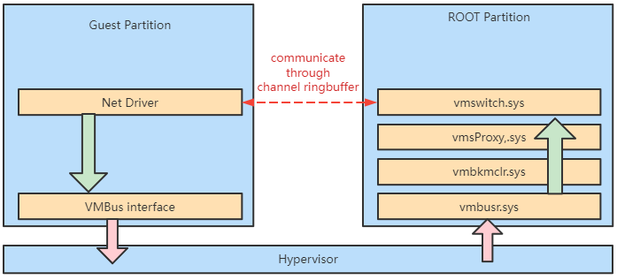
Virtual Devices Architecture Example: Net
Notes:
For example, vmswitch, as a hyperv network virtual device, the guest net driver sends messages through ringbuffer under vmbus. Messages are taken out from vmbkmclr.sys driver’s ringbuffer and then passed into vmswith.sys driver.

Slide 10
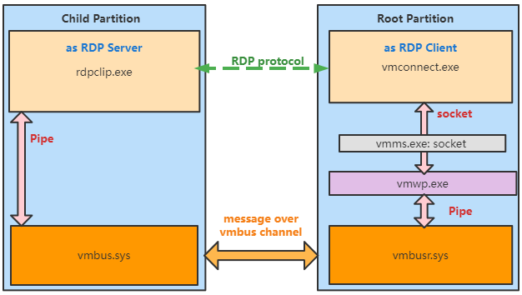
Enhanced Session Mode
Thanks @rthhh17, he shared me major information to confirm this.
Notes:
In Windows, creating high fidelity sessions to guests through TCP/IP RDP connections has always been possible, but requires a properly configured network path to the VM. The VMConnect Enhanced Mode feature allows for these high fidelity sessions when no network connectivity exists between the host and guest OS. From this picture, the Guest user program rdpclip.exe transfers messages by reading/writing pipe, and messages in the pipe will be passed to host vmwp.exe program through vmbus. And vmconnect.exe connects to vmwp.exe using socket. From the system resource monitor, it looks like that vmms.exe is connected to vmconnect.exe, but vmconnect is connecting with vmwp actually. I will discuss this later. Thus, rdpclip is running as a RDP server in Guest, and all RDP messages are transferred to vmconnect completely without modifying. So we can treat vmconnect as a RDP client. And I would like to thank my friend rthhh17, he helps me confirm this architecture.

Slide 11
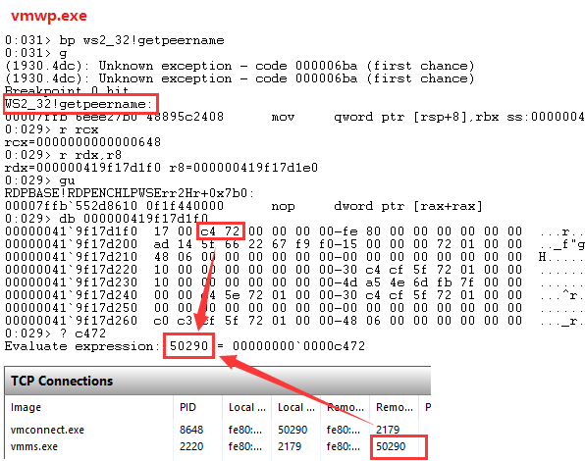
Enhanced Session Mode: socket
TCP connection in resource monitor
Notes:
Take a look at this, the windows resource monitor shows that vmconnect is connecting to vmms by src port 50290 with this ipv6 address. So I use windbg to attach vmwp, set breakpoint at getpeername, when breakpoint hits, we go until function finished, then I checked result, we can see that target port of the result is 50290, which is same as below. This means, vmconnect is connecting with vmwp actually instead of vmms

Slide 12
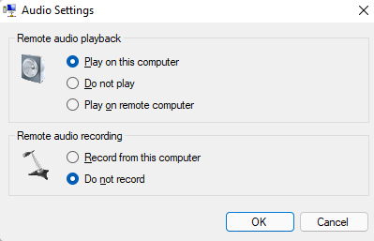
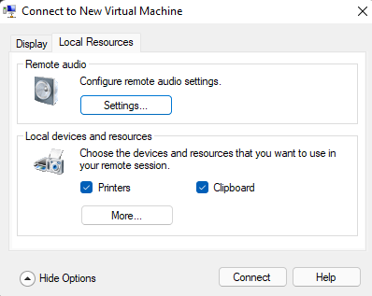
Enhanced Session Mode Features
Share Clipboard
Play Guest Audio
Share Printers
Display
Notes:
Let’s take a look at enabled features in enhanced session mode. As you can see, it allows clipboard, printers, audio and display. These features allow us to do a lot of interaction with vmconnect program.

Slide 13
Learned a lot, what’s next?
Notes:
After introducing the hyper-v’s architecture and attack surfaces, what’s next? Next is we need to understand hyper-v's difficulty.

Slide 14
Hyper-V Research Difficulty
Child Partition can call few hypercalls
No source codes, no symbols of hypervisor
Hyperseed, MS fuzzing tool with source code
Emulated Devices are not rich. (No USB, no 3D, no Audio, no alternative Net/Storage devices)
Strictly input check, Hard to occupy heap and spray heap in Host, Hard to leak information in Host …
Notes:
Even hyper-v has 245 hypercalls, guest can call few hypercalls. It means we can only get a small attack interface. Furthermore, we can’t get source codes or symbols of hypervisor, and Microsoft teams had fuzzed hypervisor using Hyperseed and other tools with source codes. It’s hard to compete with Microsoft. In addition, hyper - v is not like other platforms that provide abundant optional devices, it does not support USB, no 3D acceleration, no Audio, no alternative network or storage devices. Thus, we can only focus on fewer virtual devices, like vmswitch, storvsp, vpci and so on. Because hyper-v is paravirtualization, We can't spray much heap in the host, we can't leak information from the host easily, it will be more difficult to exploit than full virtualization architecture. Although Microsoft programmers sometimes make stupid mistakes, the overall quality of their code is very high, there will be a lot of strict inspection in emulated devices.

Slide 15

Find Our Targets
More possibilities to exploit
Complex enough
Debug Symbols
Fewer researchers discussed
Exist CVEs
Default setting
Notes:
So, is there such a target, it may have more possibilities to exploit, it is complex enough, and it has debug symbols, and is rarely mentioned, and there are history CVEs, and it's enabled under default settings?

Slide 16

Why Enhanced Session Mode
Default setting for client scenario
Recently Microsoft discloses several RDP client's vulnerabilities
RDP is complex
I found several RDP bugs in Server Side
Fewer Researchers mentioned it before
More possibilities to exploit
Client codes are usually worse than server side
Notes:
The answer is coming -- Enhanced session mode! It’s a default setting for client scenario when the guest is Windows 10. There are several RDP client’s vulnerabilities disclosures from Microsoft. RDP protocol is complex. And I used to find several RDP bugs on the server-side. Moreover, there are fewer researchers mentioned it before. And RDP client has more possibilities to exploit. Besides, Microsoft’s client codes are usually worse than the server side. And vmconnect is acted as a client. Ah ha, A perfect target, right?☺

Slide 17
Let’s learn RDP firstly
Notes:
Let’s learn RDP first

Slide 18
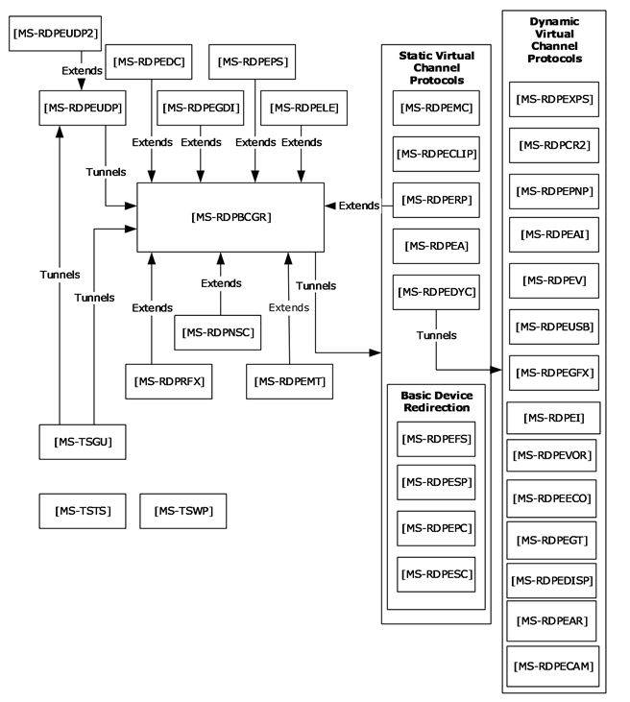
RDP Protocol
Protocol Relationship Diagram
Notes:
As you can see, there are many document protocols by Microsoft for RDP. In order to facilitate research, I mainly pay attention to virtual channels. Virtual channels are software extensions that can be used to add functional enhancements to a Remote Desktop Services application. Examples of functional enhancements might include: support for special types of hardware, audio, or other additions to the core functionality provided by the RDP. The RDP protocol provides multiplexed management of multiple virtual channels.

Slide 19
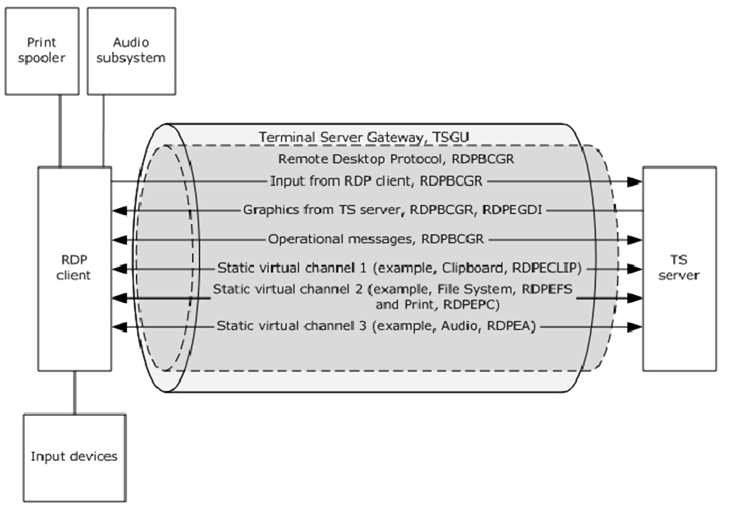
Virtual Channels
Notes:
There are two types of virtual channels here, static virtual channels and dynamic virtual channels respectively. This picture shows several mainly used virtual channels. RDPBCGR protocol is used for input from the client. RDPBCGR, RDPEGDI are used for graphics from the server side, RDPBCGR is also used for operation messages between client and server. These are dynamic channels. The pictures below are static virtual channels. RDPECLIP is used for the clipboard, our protagonist today. RDPEFS is related to the file system, RDPEPC is related to Print. And RDPEA is related to audio. From this graph, we can see that we need to focus on the protocols which contain data from the server side, like these.

Slide 20
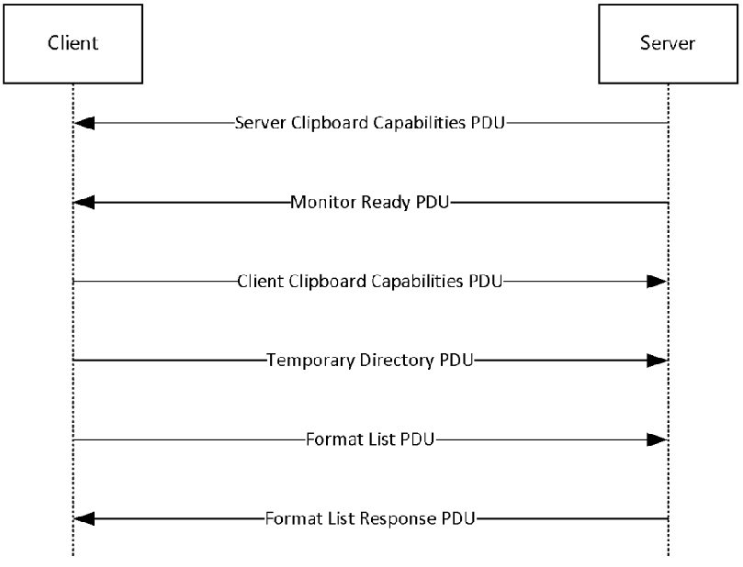
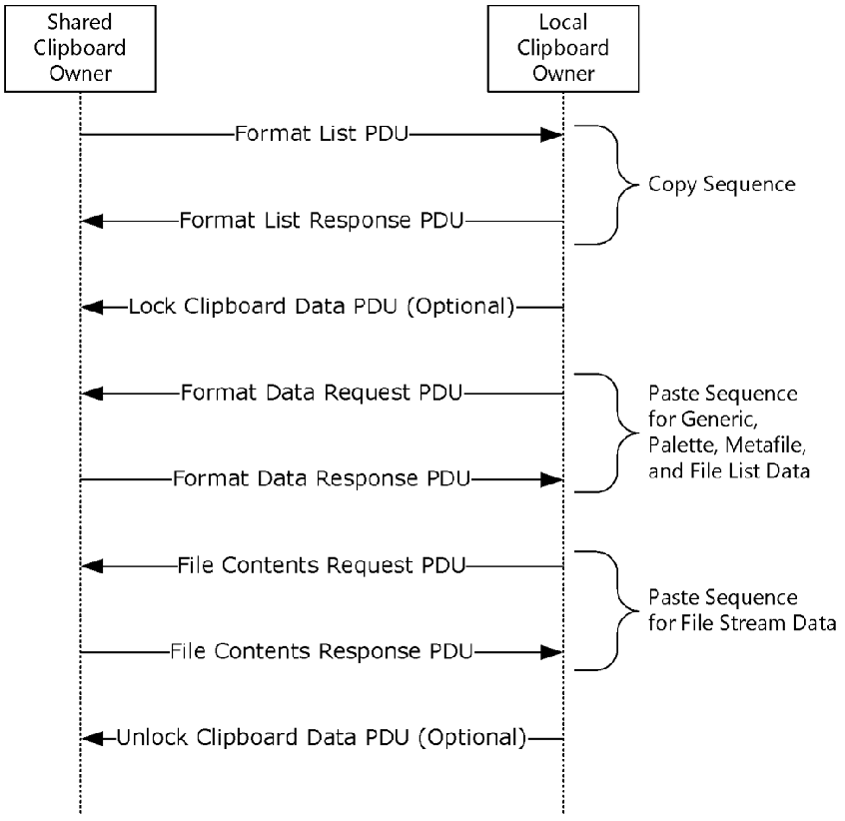
[MS-RDPECLIP] Clipboard Virtual Channel
Notes:
On the left, here is about Clipboard Redirection Initialization Sequence.
The goal of the Initialization Sequence is to establish the client and the server capabilities, exchange
settings, and synchronize the initial state of the client and server clipboards.
1. The server sends a Clipboard Capabilities PDU to the client to advertise the capabilities that it
supports.
2. The server sends a Monitor Ready PDU to the client.
3. Upon receiving the Monitor Ready PDU, the client transmits its capabilities to the server by using a
Clipboard Capabilities PDU.
4. The client sends the Temporary Directory PDU to inform the server of a location on the client file
system that can be used to deposit files being copied to the client. To make use of this location,
the server has to be able to access it directly. At this point, the client and the server capability
negotiation is complete.
5. The final stage of the Initialization Sequence involves synchronizing the Clipboard Formats on the
server clipboard with the client. This is accomplished by effectively mimicking a copy operation on
the client by forcing it to send a Format List PDU.
6. The server responds with a Format List Response PDU.
On the right, Here are Data Transfer Sequences. The diagram that follows presents a possible data transfer sequence. The goal of the Data Transfer Sequences is to perform a copy or paste operation.
When the share clipboard owner does a copy operation, it will send a format list pdu to another side. Then a format list response pdu will respond from the local clipboard owner. Next, if the local clipboard owner does a paste operation. It will send format data request pdu to shared clipboard owner and receive response pdu. Then it will send file contents request pdu to obtain file contents to another side, and the shared clipboard owner will respond file contents response PDU. Thus, the copy and paste operation is finished.

Slide 21
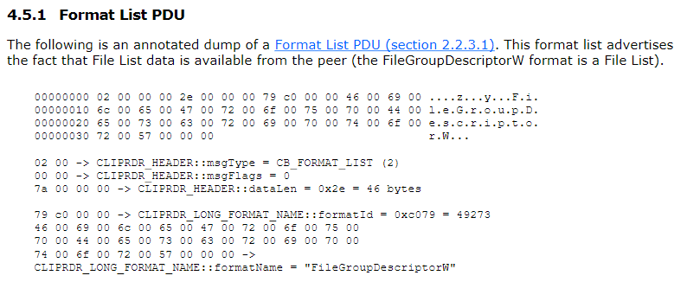
Copy and paste
Notes:
Here is an example of detailed data during copy and paste operation. Firstly, the Share clipboard owner sends format list pdu to the local clipboard owner, this pdu contains format ID 0xc079 corresponding to format name “FileGroupDescriptorW”. All data copied to a system clipboard has to conform to a format specification, known as a Clipboard
Format. Each Clipboard Format is identified by a unique numeric format ID. This format ID is used to
tag the data on the clipboard so that any application enumerating the contents of the clipboard is able
to determine the format of the data without having to extract and analyze it. the File List format type uses “FileGroupDescriptor” hard-coded Clipboard Format name, when referring to File List data within the context of the Clipboard Virtual
Channel Extension PDUs, this Clipboard Format name is always used.

Slide 22
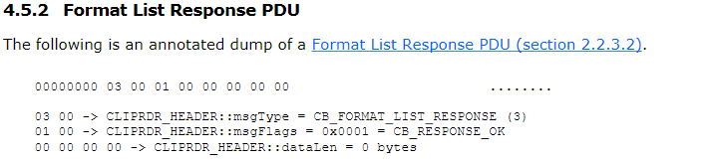
Copy and paste
Notes:
Then local clipboard owner respond format list response pdu with flags CB_RESPONSE_OK.

Slide 23
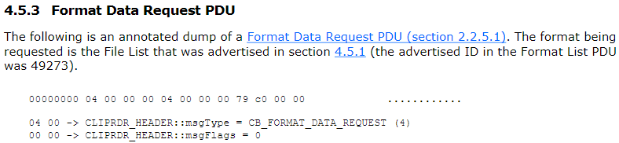
Copy and paste
Notes:
Next, when a local user does a paste operation. A format data request pdu will be sent to the shared clipboard owner. In this case, it requires data with format ID 0xc079.

Slide 24
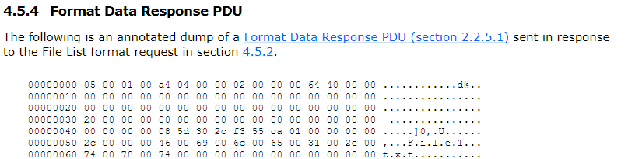
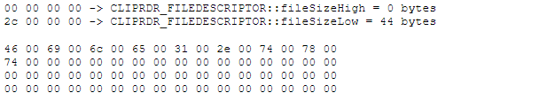
Copy and paste
Notes:
Then, shared clipboard owner responses format data response pdu. Here, it responds file name “File1.txt”. Next, we start tracing how the client is receiving and handling messages.

Slide 25
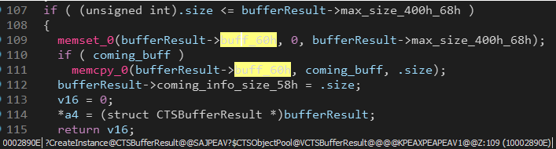
Client: Receive Msg
mstscax!CTSBufferResult::CreateInstance
mstscax!CTSCoreEventSource::FireASyncNotification
mstscax!CClipRdrPduDispatcher::DispatchPdumstscax
mstscax!CClientRdrVirtualChannel::OnVirtualChannelPdu
Part of mstscax!CTSBufferResult::CreateInstance
Notes:
Here is part of the CTSBufferResult::CreateInstance function codes. The above is the function call stack. CTSBufferResult::CreateInstance will create a structure variable name bufferResult, store incoming protocol message to +60h filed, and its length is assigned to filed 58h. Remember this function CTSCoreEventSource::FireASyncNotification with green color.

Slide 26
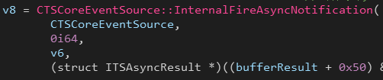
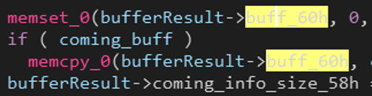
Client: Receive Msg
mstscax!CTSThread::AddCallback
mstscax!CTSCoreEventSource::InternalFireAsyncNotification
mstscax!CTSCoreEventSource::FireASyncNotification
buffer at +60h of bufferResult
size at +58h of bufferResult
Part of mstscax!CTSCoreEventSource::FireASyncNotification
Notes:
Next, CTSCoreEventSource::FireASyncNotification will call CTSCoreEventSource::InternalFireAsyncNotification, as this picture shows, It puts the bufferResult with 0x50 offset as a parameter into function CTSCoreEventSource::InternalFireAsyncNotification.

Slide 27
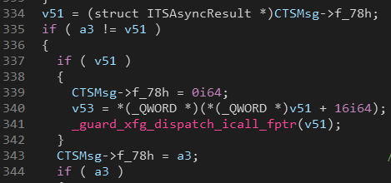
Client: Receive Msg
mstscax!CTSThread::AddCallback
mstscax!CTSCoreEventSource::InternalFireAsyncNotification
mstscax!CTSCoreEventSource::FireASyncNotification
buffer at +10h of f_78h
size at +08h of f_78h
Part of mstscax!CTSThread::AddCallback
Notes:
Then, mstscax!CTSThread::AddCallback will be called in mstscax!CTSCoreEventSource::InternalFireAsyncNotification
. In mstscax!CTSThread::AddCallback, it assigns bufferResult+0x50 to CTSMsg’s f_78h field. Because arguments adds 0x50, real buffer pointer is stored at +10h offset of f_78h pointer. Size is at +08h of f_78h pointer.

Slide 28
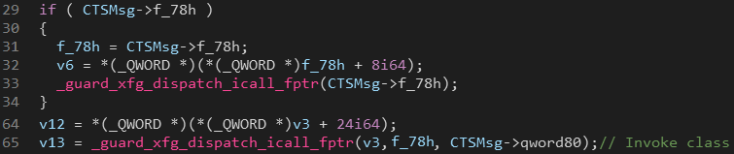
Client: Receive Msg
mstscax!CClipBase::OnFormatDataResponse
mstscax!CClipBase::OnFormatDataResponseAsyncCallback::Invoke
mstscax!CTSMsg::Invoke+0x10e
mstscax!CTSThread::RunAllQueueEvents+0x34a
mstscax!CTSThread::internalMsgPump+0xb4
Part of mstscax!CTSMsg::Invoke
Notes:
In function CTSMsg::Invoke, it will call message’s invoke function, in this picture, at line 31, it gets f_78h from CTSMsg, then put it to invoke function as an argument. This is the call stack of the Format Data Response invoker. It called CClipBase::OnFormatDataResponseAsyncCallback::Invoke function to handle coming message. Next, it calls CClipBase::OnFormatDataResponse.

Slide 29
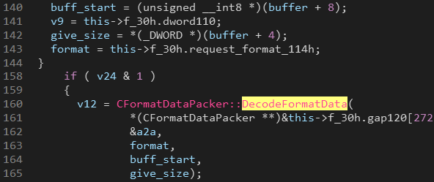
Client: CClipBase::OnFormatDataResponse
size at +08h of f_78h
buffer at +10h of f_78h
Notes:
In CClipBase::OnFormatDataResponse, it calls a dynamic function to get buffer and size from a2, which is f_78h. Later, the following format size is taken out from the buffer. And format ID is picked out from another structure. After that, it calls CFormatDataPacker::DecodeFormatData

Slide 30
Let’s learn cases before digging
Notes:
Through the previous series of processes, we know how the client is receiving and handling COPY and PASTE related data flows. Now, let's study 2 famous cases.

Slide 31
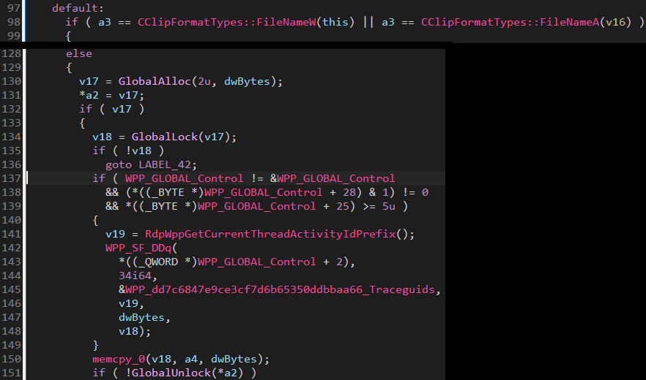
CVE-2019-0887
VM:rdpclip.exe
Host:vmconnect.exe
No check for FileGroupDescriptorW/FileGroupDescriptorA
Part of CFormatDataPacker::DecodeFormatData
Notes:
First case is CVE-2019-0887, it was found by Checkpoint researcher. On the right, rdpclip acts as shared clipboard owner when the guest user updates clipboard, so the host process vmconnect acts as local clipboard owner. When the host user does a paste operation, vmconnect will send a Format Data Request PDU to the Guest. And rdpclip will respond Format Data Response PDU to vmconnect. Finally, vmconnect will call CFormatDataPacker::DecodeFormatData function to handle this PDU. a3 is the format ID of request data. The function doesn’t check the file name when the format type is FileGroupdescriptorW or FileGroupdescriptorA. Therefore, the file name containing “\..\” will be put into the local clipboard. Thus, we can trigger the Path Traversal in vmconnect process and drop an arbitrary file on the host.

Slide 32
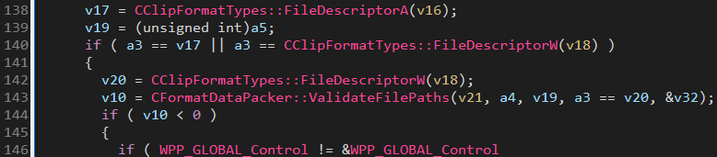
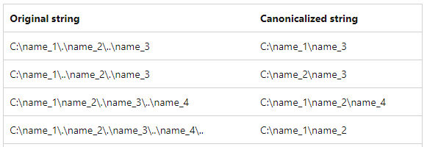
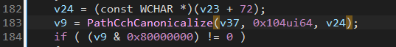
CVE-2019-0887 patch
Part of CFormatDataPacker::DecodeFormatData
PathCchCanonicalize: Converts a path string into a canonical form.
Part of CFormatDataPacker::ValidateFilePaths
Notes:
Later, Microsoft released the patch of CVE-2019-0887. It uses the PathCchCanonicalize function to validate the file path when the format name is “FileDescriptor”. This function converts a path string into a canonical form like these examples. The patch seems ok.

Slide 33

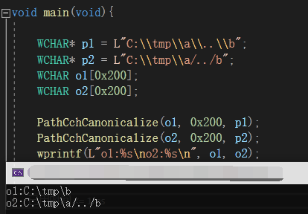
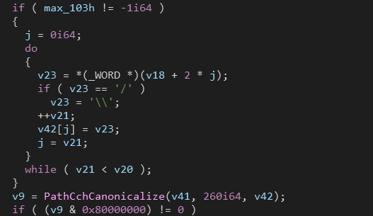
CVE-2020-0655
New Patch
!!!!
Notes:
However, look at this picture, I wrote an example of using PathCchCanonicalize, it doesn’t convert “/../”! But Windows parses “/…/”! So we can bypass that patch. Thus, Microsoft decides to change “/” to “\” before calling PatchCchCanonicalize. The end.

Slide 34
Really?

Slide 35
A story of my finding
Notes:
Now, it’s time to show my finding.

Slide 36
Remind
ReadFile
WriteFile
Notes:
First of all, let’s review this picture, guest process used a pipe to read and write messages from vmconnect. So we can modify its message before sending it to vmconnect by hooking WriteFile Function

Slide 37
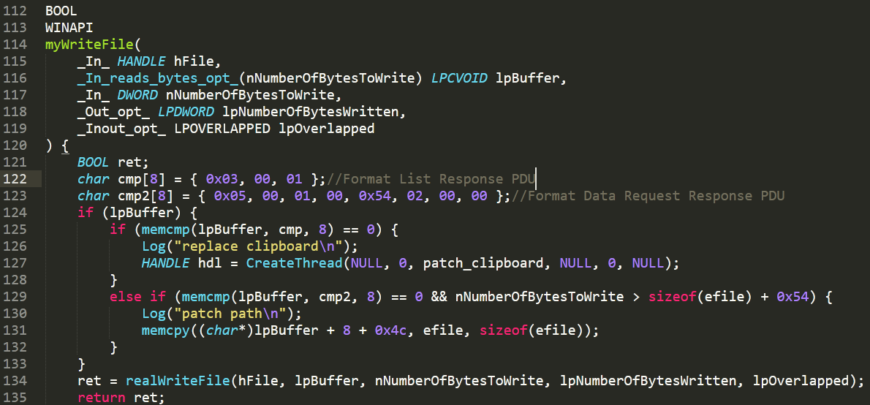
Try Reproduce CVE-2019-0887 on Win11
Notes:
So I wrote this simple POC to reproduce cve-2019-0887 on Windows 11. I hooked the WriteFile function of rdpclip. If rdpclip is trying to send Format List Response PDU, it means the host side is updating the clipboard, and rdpclip acts as local clipboard owner. So I update the clipboard with “CF_HDROP” format. And rdpclip acts as shared clipboard owner now, when rdpclip is trying to send Format Data Response PDU, I changed its file name to my evil file path. Windows 11 has patched this bug, so my poc should only trigger the bug path.

Slide 38
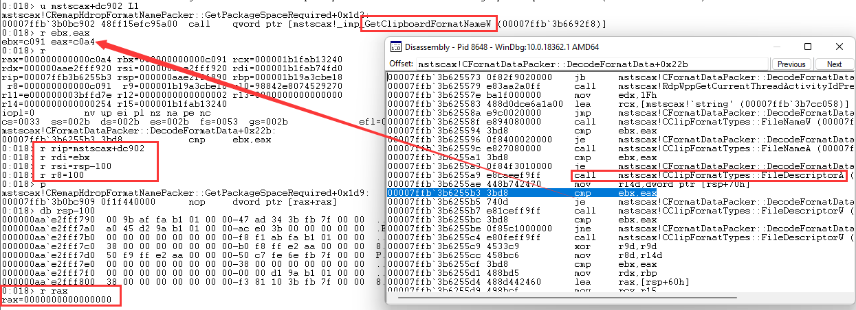

Unbelievable finding
Notes:
However, to my surprise, when vmconnect tries to compare format ID with the result from CClipFormatTypes::FileDescriptorW/A, they don’t match! Look at this, ebx is the format ID to be compared, eax is the result of this function. We can confirm that they don’t match. So I set rip to mstscax+dc902, where points to the instruction that calls GetClipboardFormatName. Then I put this format ID as an argument, I get a result 0, indicating that the requested format ID sdoes not exist or is predefined. What happened???

Slide 39
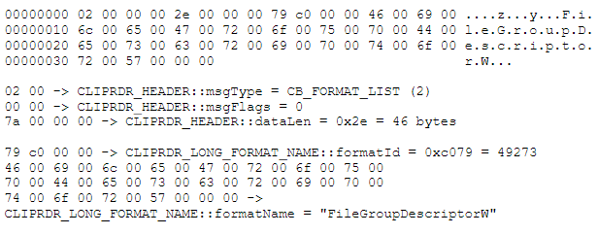
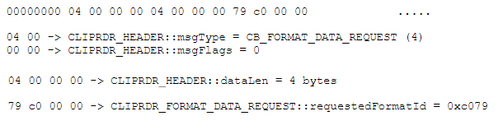
Example of RDP streaming
Format List
Format Data Request
VM: rdpclip.exe
Host: vmconnect.exe
Format List
Format Data Request
Notes:
Let’s review the processing of copy and paste. The shared clipboard owner sends format list pdu to the other side when Guest updates clipboard. And local clipboard owner sends format data request pdu when the host user does paste operation. In format list pdu, it contains format id and its format name in Guest. And in format data request pdu, it requests data using format ID from format list pdu.

Slide 40
So, client uses format ID from server, but it doesn’t exist on client machine?

Slide 41
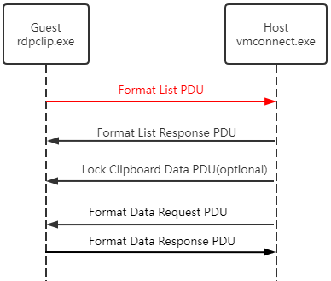
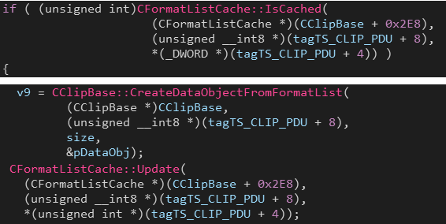
Review my finding
0 CClipBase::OnFormatList
1 CClipClient::OnFormatList
2 CClipClient::OnFormatListAsyncCallback::Invoke
Notes:
To figure out this, let’s try to understand what happened when the client received format list pdu. Here is part code of function CClipBase::OnFormatList. This is its call stack.
Firstly, it will check its cache to make sure whether this format name has been cached. If it’s not cached, it will try to register this format name and pair the remote format id with the local format id. Then cached them.

Slide 42
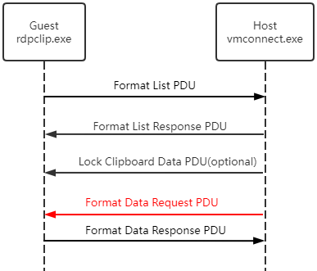
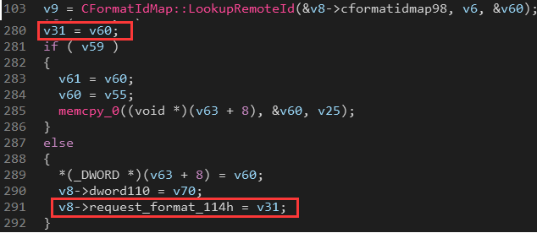
Review my finding
CClipBase::SendFormatDataRequest
Notes:
When host sends format data request, in CClipBase::SendFormatDataRequest
function. it will find the remote format ID corresponding to the requested local Format ID. Then sends it to the server. However, it also stores remote format ID to v8's 114h filed.

Slide 43
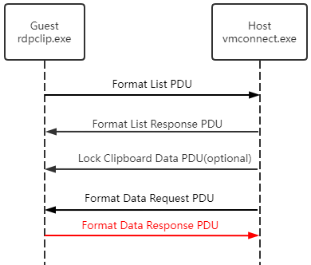
Client: Handle FormatDataResponse
Notes:
When handling format data response PDU, it gets format ID from 114 filed and puts it into function DecodeFormatData. In DecodeFormatData, it compares remote format ID with local format ID. That's why the server's Format ID doesn't exist locally.

Slide 44
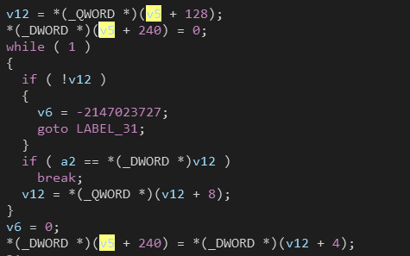
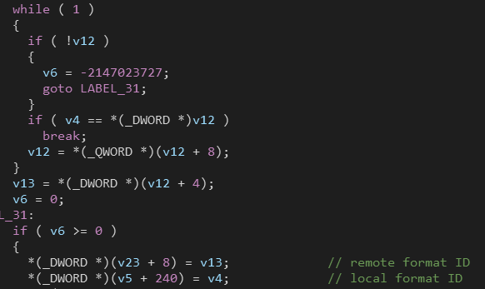
Why could this happen?
Before
Patch
origin
cve-2019-0887
After
They have made mistakes at the beginning!!! 🙄
Notes:
Why would this happen??? Why windows 11 has such an absurd bug after fixing two path traversal bugs? Let’s look at codes before patching cve-2019-0887. Here, this while loop is fetching remote format id with local format id which is a2. Then it stores remote format ID to v5’s filed. On the right, these are part codes of the same function after fixing the bug. As you can see, it stores local format ID to the same filed. So, we have a conclusion that they have made mistakes at the beginning. CVE-2019-0887 contains two bugs!!!

Slide 45

I submitted it to MSRC with format ID incorrect use reason
$150,000
Notes:
In short, in the end, I made a clear explanation to MSRC, and I thought this bug would fetch Tier2 description in Hyper-V Bounty Program and I can get $150,000 rewards.

Slide 46


CVE-2019-0887* (name it StupidFetch)
MSRC said that RDP related bugs don’t fetch Hyper-V Bounty Program
MSRC won’t assign a new CVE ID for it, because it is code regression.
Notes:
Disappointingly, MSRC thinks RDP related bugs don't fetch Hyper-v Bounty Program, even if this bug can be used by default setting in client scenario. Furthermore, MSRC won't assign a new cve id for it, because they think it is code regression. To distinguish this new bug from the old one, I named it StupidFetch.

Slide 47
Timeline
14/07/2021 report to MSRC
27/07/2021 confirmed by MSRC
29/07/2021 Award $5000 as important RCE under Windows Bounty Program
start arguing…
08/11/2021 MSRC updated Hyper-V bounty page, declare RDP is out of scope
keep arguing …
14/12/2021 MSRC silently release patch for windows 11/ Server 2022
30/12/2021 MSRC told me they released patch in December patch
17/01/2022 Last email about bounty argument with MSRC, nothing changed
Notes:
Here is the timeline for my report. MSRC decided to award $5000 for this bug, and changed hyper-v bounty rules that RDP is out of scope. And on 14/12/2021, they silently released a patch. Although I argued with them for a long time, nothing changed.

Slide 48
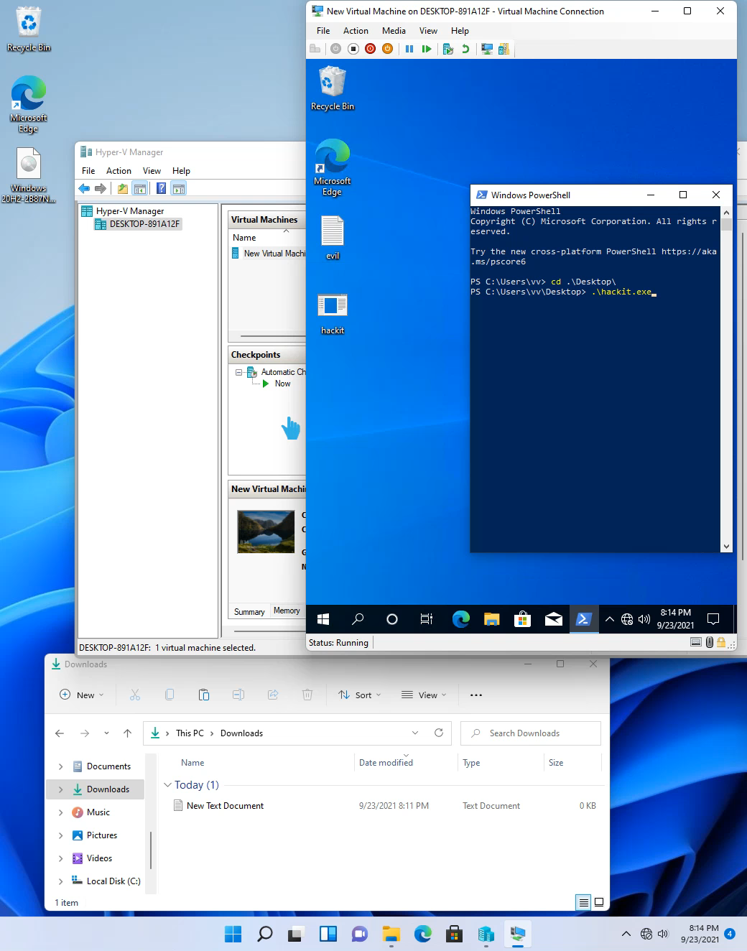
Demo
Notes:
Here is a demo. I hooked rdpclip’s writefile function. When the host user does a copy operation, the guest will update the clipboard, next time, a controlled file from the guest appears on the host user’s desktop when the host user does a paste operation. If we want to execute any program on a host computer, we need additional steps.

Slide 49
Conclusion
Path Traversal always surprises us
Try old bugs on Windows newest system ☺
Enhanced Session Mode is a good attack surface
Always be careful of VM, even Hyper-V
MSRC have the final explanation right
Notes:
Conclusion. Path traversal is a good method. We should always try it during research. Next, try old bugs on windows’ newest system. I have discovered several bugs through this method. Enhanced Session Mode is a good attack surface
even if Microsoft doesn’t pay too much award, I believe the RDP client exists more bugs. And, Be careful when using the virtual machine, even you are using hyper-v. Tips, MSRC has the final explanation right. Be careful!

Slide 50
References
https://thalium.github.io/blog/posts/fuzzing-microsoft-rdp-client-using-virtual-channels/
https://i.blackhat.com/USA21/Wednesday-Handouts/us-21-Mobius-Band-Explore-Hyper-V-Attack-Interface-Through-Vulnerabilities-Internals.pdf
https://research.checkpoint.com/2020/reverse-rdp-the-path-not-taken/
https://research.checkpoint.com/2019/reverse-rdp-the-hyper-v-connection/
https://docs.microsoft.com/en-us/virtualization/hyper-v-on-windows/reference/hyper-v-architecture
https://docs.microsoft.com/en-us/openspecs/windows_protocols/ms-rdpeclip/fb9b7e0b-6db4-41c2-b83c-f889c1ee7688
Notes:
Here are references.

Slide 51
Q&A
Notes:
That’s all. Thank you. You can ask me if you have any questions.

